Slide 1


Slide 2
Sustainability Aspects
of
Centre for Transfer of Innovation
Presented by
Dr.Ashraf Bany Mohammed
Director of Innovation and Etreuenrhsip Center
The University of Jordan
a.bany@ju.edu.jo

Slide 3

Whys should we care?
Three Main reasons:
  No more funds are available
  To be able to plan on the long run
  To have the resources needed for long term plans

Slide 4
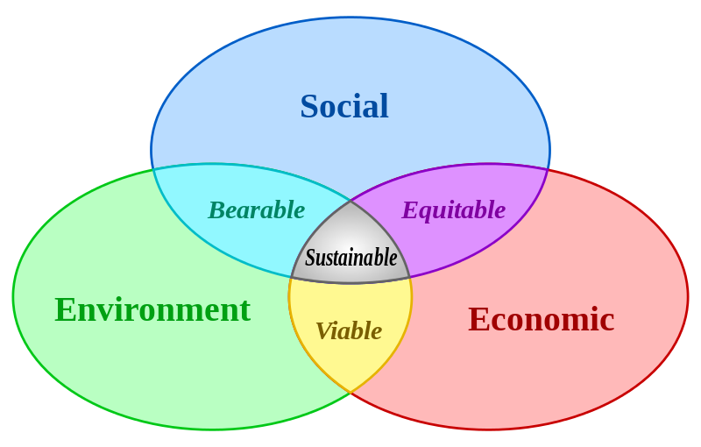
What is CTI sustainability
What is sustainability???
  sustainability is “the ability to be maintained at a certain rate or level”
Business sustainability represents resiliency over time (businesses that can survive shocks because they are intimately connected to healthy economic, social and environmental systems)
How do we see CTI sustainability?
  the ability to maintain and manage a long-term adequate financial and social resources that support our operations.

Slide 5

CTI sustainability plans
Financial sustainability
  Strategic Planning
  Managing costs
  Fundraising plan
  Planning for profit
    Rental income
    Fee based training.
    Event sales.
    Investment

Slide 6

CTI sustainability plans
Financial sustainability
  Plan partnership with Investors
  Co-finance
  More projects

Slide 7

CTI sustainability plans
Social sustainability
  Stakeholder engagement (Students , faculty, and Administration)
  Community outreach and Community Leadership.
  Promoting inclusion for all, equality , rights, development and responsibility of all
  Building a Community of Volunteers

Slide 8
It is always a challenge between Microeconomic efficiency against macroeconomic impact

